Slide 2
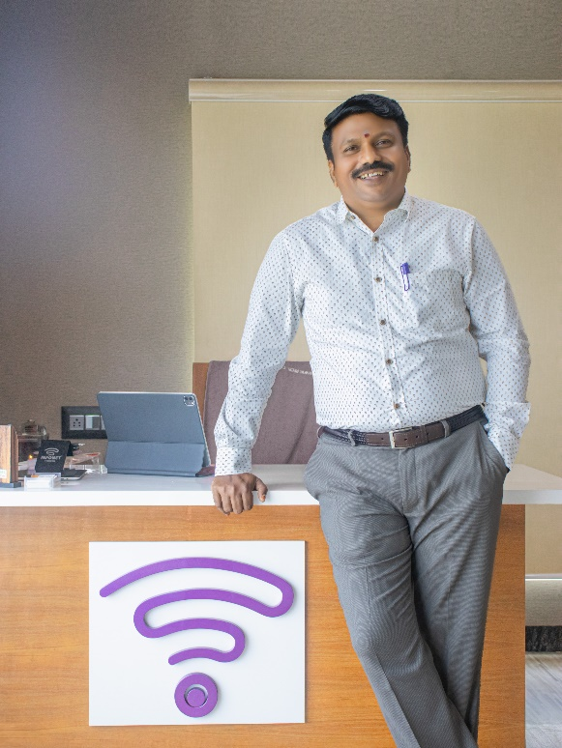
Mr. Ravikumar Chinnusamy Managing Director
Founder and Managing director, He is an Agri graduate done his Master in Business administration. He is been successfully running this organization for more than 15 years.

Slide 3
CATEGORY A LICENSE

Slide 4
CERTIFICATE OF PM WANI

Slide 5
GROUP OF COMPANY

Slide 6
INFONET
Started its journey in the year of 2005, A Class - A Internet Service Provider, Serving customers with Internet Leased Lines, Broad Band Along with the adjacent Value Added services. Large scale network projects being the current and future focus. Covering more than 1.2 Million Sq. Kilometres.
Developed and deployed networks that substantially enhances the capabilities of current 802.11 standards based wireless technology to enable mass adoption and integration in challenging and rough terrains where Line of Sight is a challenge.
Integrating technologies to provide reliable, sustainable and affordable network for the end user has been our value addition and growth. Capabilities in Passive and Active Infrastructure give added advantage

Slide 7
INFONET TIMELINE
40+ BRANCHES & OWN R&D INFRA PROVIDER
CUSTOMER CARE SERVICE
2005
2015
2025
2010
2020
OWN DATA CENTER
ESTABLISHMENT
YEARLY TARGET 5CORE

Slide 8
CORE VALUES
VALUE
VISION
Customer
Experience
People Knowledge
Innovation Commitment
MISSION
Be an integral part of our government’s vision of connecting the rural areas, and ensuring every citizen in our country gets high-speed internet
Our mission is to close the digital divide, between the served and underserved areas.

Slide 9
OWN INFRA

Slide 10
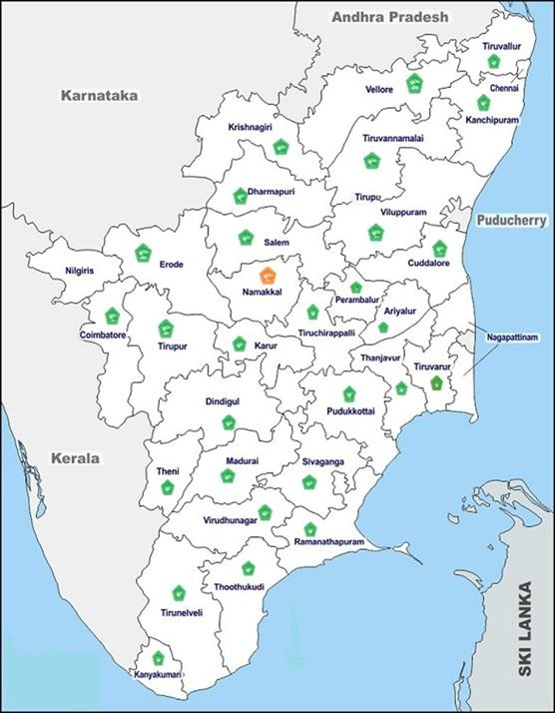
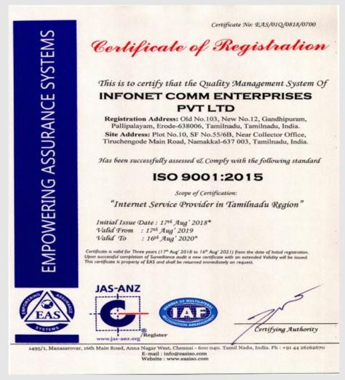
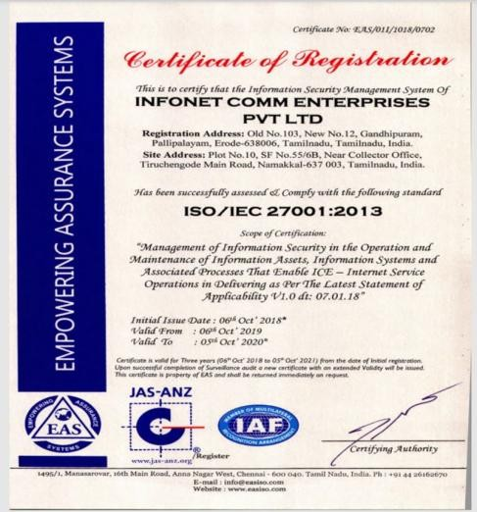
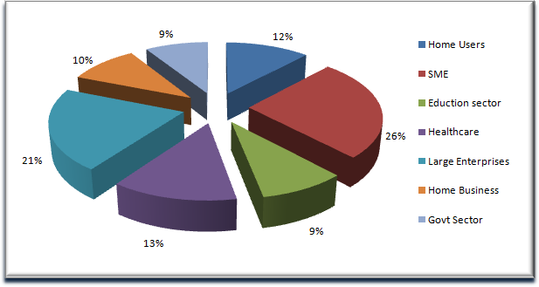
INFONET OVERVIEW
Own Offices
Our Assets
Certifications
20K+ Customers 1Lakh+ Users Benefited through E Shiksha Project 450+ Employees
Stores & Inventory 1.9 cr 1 Rupee Internet through Netbox Rural Empowerment through Infonet Centre
Own offices to cover all districts
540+ Towers 20G +Bandwidth
Long term Partners & Vendors

Slide 11
OUR FIBER DISTRICTS
NAMAKKAL RASIPURAM SALEM ERODE
DHARMAPURI
KRISHNAGIRI
PALACODE
MADURAI
PALLIPALAYAM
PUDUKOTTAI
PERAMBALUR & ARIYALUR
SULUR CUDDALORE KALLAKURCHI

Slide 12
CERTIFICATE INFORMATION SECURITY SYSTEM

Slide 13
PM WANI
RESIDENT
TEMPLE
RETAIL BASE
SCHOOLS
GRAM Panchayats
HOSPITAL

Slide 14
HIGHLIGHTS OF INFONET
24/7 Customer support with more than 50 branches across Tamilnadu
Provide service with SLA on 95% Uptime.
Internet service with Best device Cambium and Cisco
Point to Point connectivity so there is no drop in bandwidth
Bandwidth from Bharti Airtel, Vodafone, TATA and Reliance which gives seamless connection.
Last mile in OFC and RF Based on feasibility, we have more than 10,000 RF Links access across Tamilnadu.
Expertise in Wireless Connectivity.
Offers solution on secure Internet Access Systems and Network Management.
We provide more customized products based on customer requirement which includes CCTV, Wi-Fi, Intranet, Biometric, LAN, Firewall, Intercom, GPS Tracking, Door Sensor, Video Conferencing, Mobile Jammer, etc.,
Authorized Partners for CISCO, Cambium, TP-Link, MikroTik and Ubiquiti., We Offer Solution on Campus Wide networking as well.

Slide 15
KINDS OF VALUE ADDED SERVICE
CCTV
NETWORKING
BIOMETRIC
LAN
FIREWALL
GPS
VIDEO CONFERENCE
GATE AUTOMATION
HOME AUTOMATION
BILLING SOFTWARE
FIRE ALARM
LIVE STREMING

Slide 16
CONNECTING THE UNCONNECTED
Our Establishment continues wherever remote villages do not have access to Internet service. We submit this video as an attempt at our goal of "Internet Towards the Villages".
THANK YOU

